Slide 1
TECH LAYOFFS ANALYSIS USING SQL

Slide 2
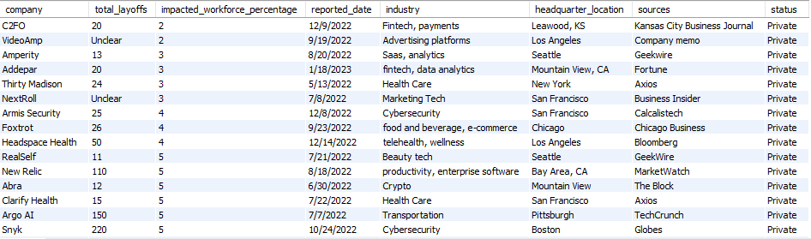
DATASET

Slide 3
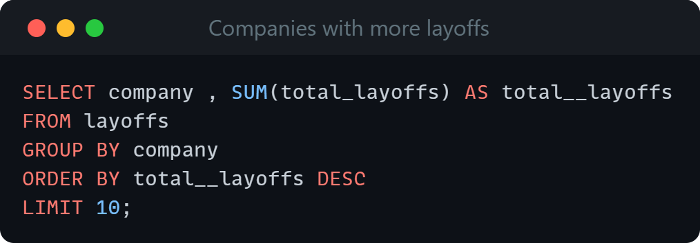
Companies with the highest number of layoffs:
ANALYSIS

Slide 4
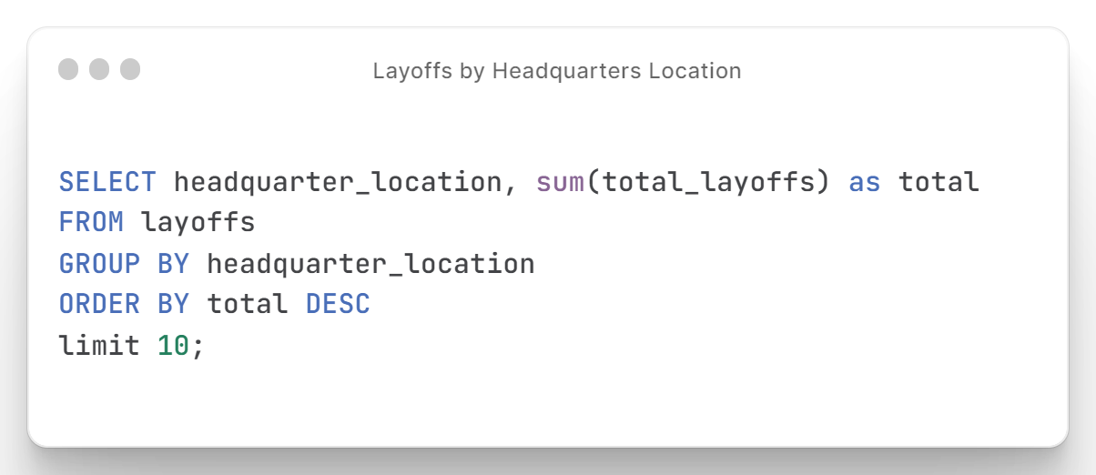
Layoffs by Headquarters Location:

Slide 5
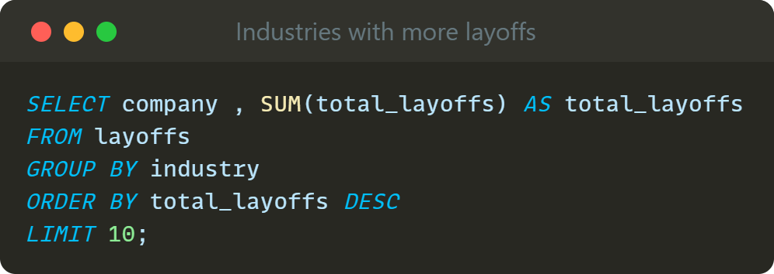
Industries with the highest number of layoffs:

Slide 6
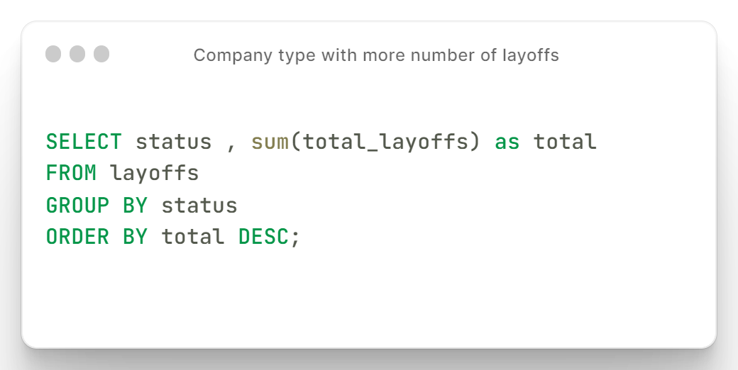
Type of companies with the highest number of layoffs:

Slide 7
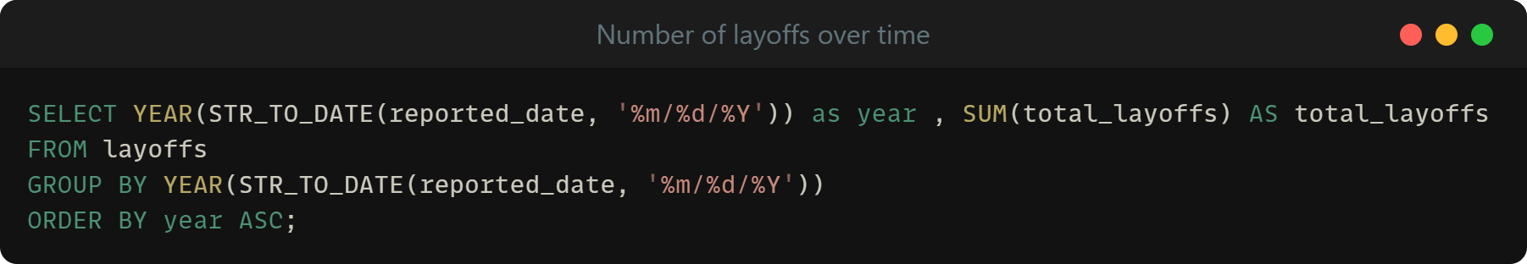
Trend in the number of layoffs over time:

Slide 8
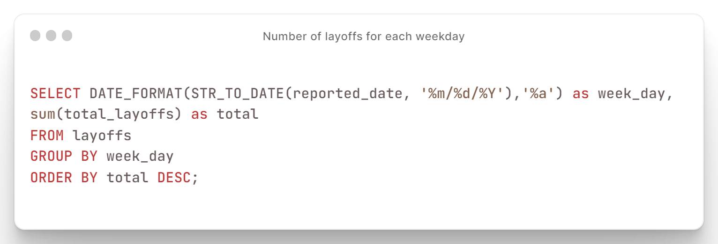
Weekdays with the highest number of layoffs:

